Slide 1
Matrix Approach to Linear Regression
Dr. Frank Wood

Slide 2
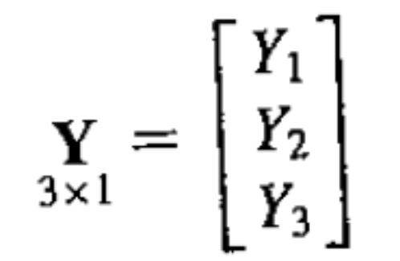
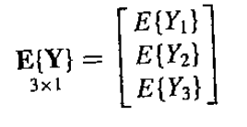
Random Vectors and Matrices
Let’s say we have a vector consisting of three random variables
The expectation of a random vector is defined

Slide 3
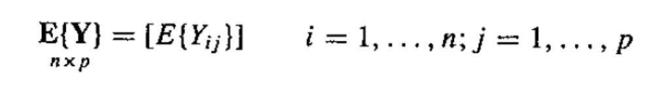
Expectation of a Random Matrix
The expectation of a random matrix is defined similarly

Slide 4
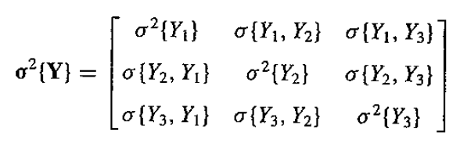
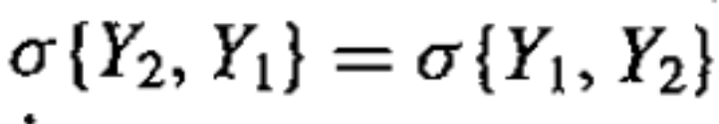
Covariance Matrix of a Random Vector
The collection of variances and covariances of and between the elements of a random vector can be collection into a matrix called the covariance matrix
remember
so the covariance matrix is symmetric

Slide 5
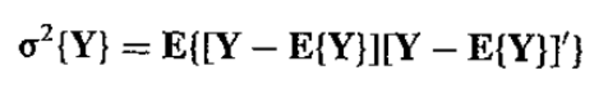
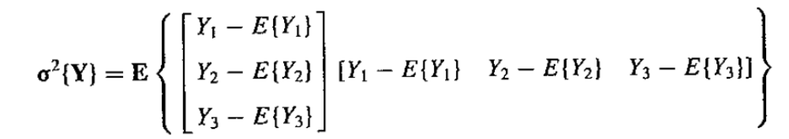
Derivation of Covariance Matrix
In vector terms the covariance matrix is defined by
because
verify first entry

Slide 6
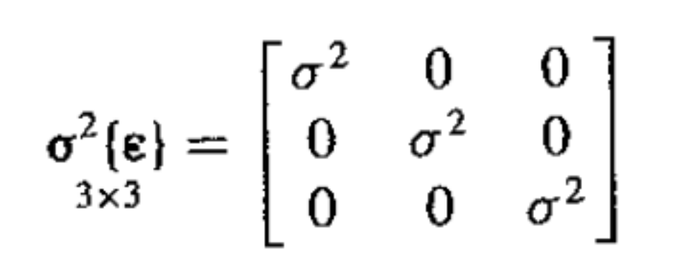

Regression Example
Take a regression example with n=3 with constant error terms ¾²{²_{i}} = ¾² and are uncorrelated so that ¾²{²_{i}, ²_{j}} = 0 for all i ≠ j
The covariance matrix for the random vector ² is
which can be written as

Slide 7

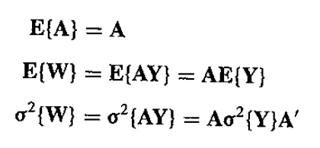
Basic Results
If A is a constant matrix and Y is a random matrix then
is a random matrix

Slide 8
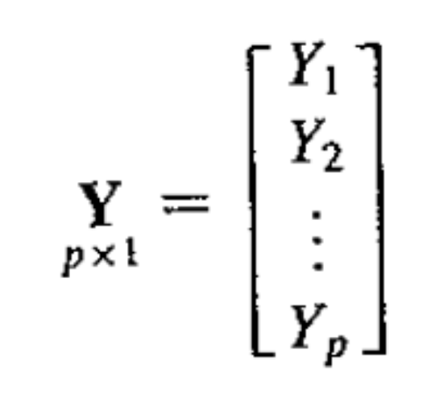
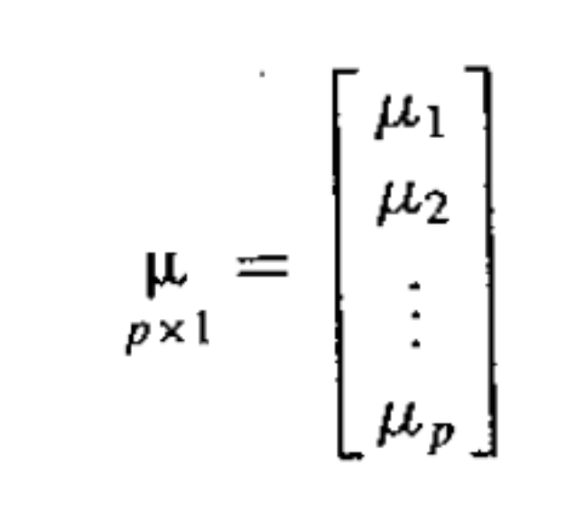
Multivariate Normal Density
Let Y be a vector of p observations
Let ¹ be a vector of p means for each of the p observations

Slide 9
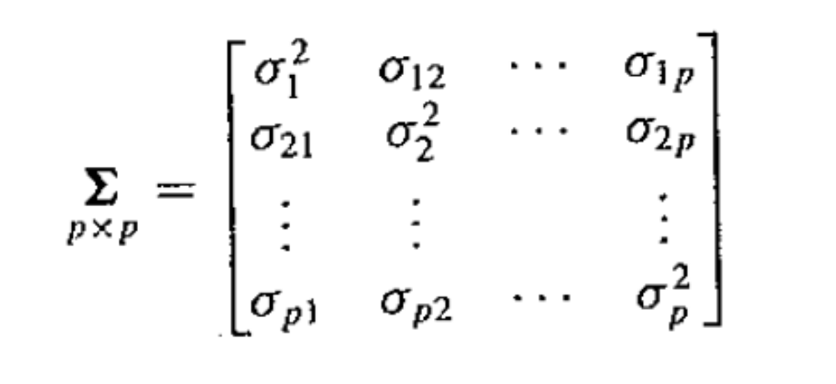
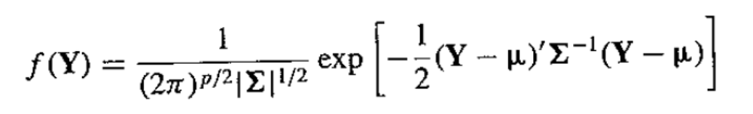
Multivariate Normal Density
Let § be the covariance matrix of Y
Then the multivariate normal density is given by

Slide 10
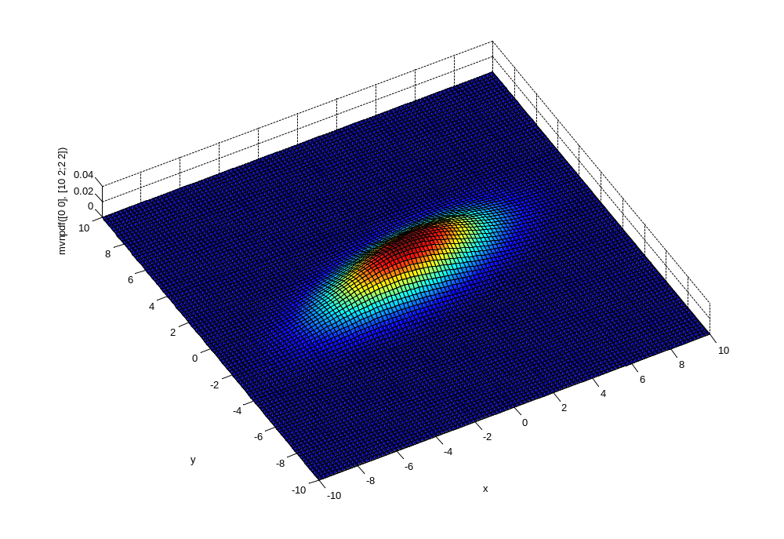
Example 2d Multivariate Normal Distribution
Run multivariate_normal_plots.m

Slide 11
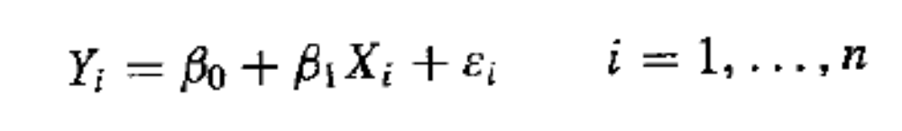
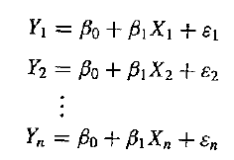
Matrix Simple Linear Regression
Nothing new – only matrix formalism for previous results
Remember the normal error regression model
This implies

Slide 12
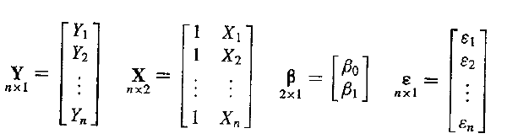
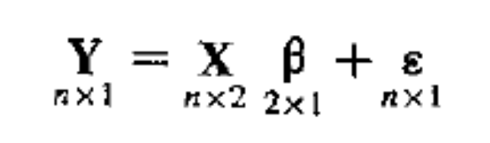
Regression Matrices
If we identify the following matrices
We can write the linear regression equations in a compact form

Slide 13
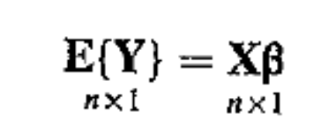
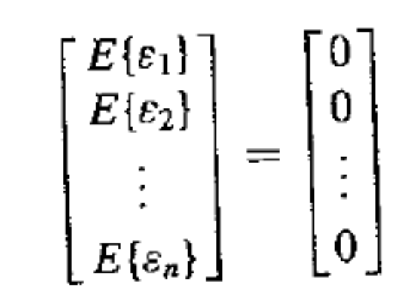

Regression Matrices
Of course, in the normal regression model the expected value of each of the ²_{i}’s is zero, we can write
This is because

Slide 14
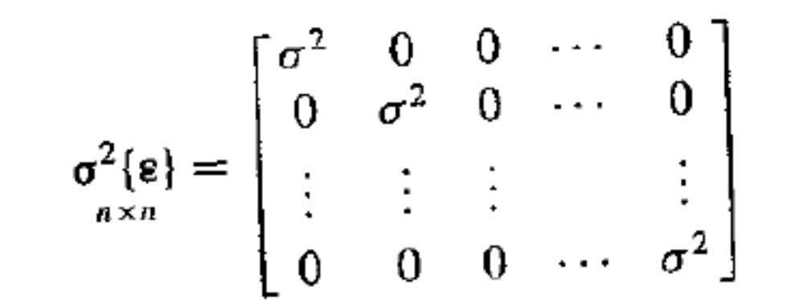
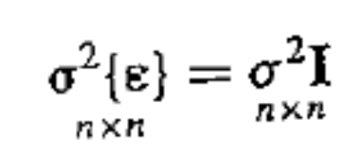
Error Covariance
Because the error terms are independent and have constant variance ¾²

Slide 15
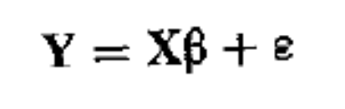

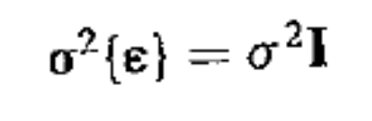
Matrix Normal Regression Model
In matrix terms the normal regression model can be written as
where
and

Slide 16
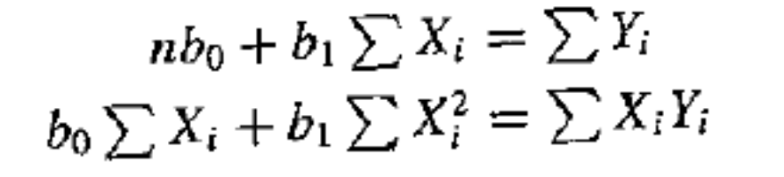

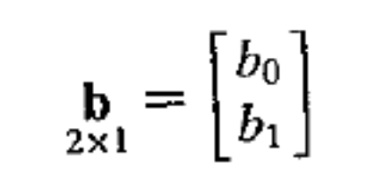
Least Squares Estimation
Starting from the normal equations you have derived
we can see that these equations are equivalent to the following matrix operations
with
demonstrate this on board

